Slide 1
A Brief History of Artificial Intelligence

Slide 2
What is AI ?
What is intelligence?
Intelligence is the ability to acquire and apply knowledge, solve problems, and adapt to new situations effectively.
What is Artificial intelligence?
Artificial Intelligence is an exciting scientific discipline that studies how we can make computers exhibit intelligent behavior, e.g. do those things that human beings are good at doing.
Example

Slide 3
Weak AI vs. Strong AI
Weak AI | Strong AI
Weak AI refers to AI systems that are designed and trained for a specific task or a narrow set of tasks. | Strong AI, or Artificial General Intelligence (AGI), refers to AI systems with human-level intelligence and understanding.
These AI systems are not generally intelligent; they excel in performing a predefined task but lack true understanding or consciousness. | These AI systems have the ability to perform any intellectual task that a human being can do, adapt to different domains, and possess a form of consciousness or self-awareness.
Examples of weak AI include virtual assistants like Siri or Alexa, recommendation algorithms used by streaming services, and chatbots that are designed for specific customer service tasks. | Achieving Strong AI is a long-term goal of AI research and would require the development of AI systems that can reason, learn, understand, and adapt across a wide range of tasks and contexts.
Weak AI is highly specialized and does not possess human-like cognitive abilities or general problem-solving capabilities beyond its narrow domain. | Strong AI is currently a theoretical concept, and no AI system has reached this level of general intelligence

Slide 4
Strong Methods and Weak Methods
Weak methods in Artificial Intelligence use systems such as logic, automated reasoning, and other general structures that can be applied to a wide range of problems but that do not necessarily incorporate any real knowledge about the world of the problem that is being solved.
In contrast, strong method problem solving depends on a system being given a great deal of knowledge about its world and the problems that it might encounter.

Slide 5
Alan Turing
Turing Test
To check whether or not machines can think intelligently like humans.
Goal: To check success of an intelligent computer
Idea: If a person who interrogated the computer could not tell if it was a human or a computer, then to all intents and purposes, Turing said, it is intelligent.
Design: The interrogator is given access to two individuals, one of whom is a human and the other of whom is a computer. The interrogator can ask the two individuals questions, but cannot directly interact with them. Probably the questions are entered into a computer via a keyboard, and the responses appear on the computer screen.

Slide 6
AI Programming Languages
PROLOG and LISP.
PROLOG (PROgramming in LOGic)
It builds a database of facts and rules, and then to have the system answer questions by a process of logical deduction using the facts and rules in the database.
Facts Example:
tasty (cheese).
made_from (cheese, milk).
contains (milk, calcium).
Rules Example:
contains (X, Y) :- made_from (X, Z), contains (Z, Y).
If X is made from Z and Z contains Y then X contains Y.

Slide 7
LISP (LISt Programming)
LISP is based around handling of lists of data.
A list in LISP is contained within brackets, such as: [A B C].
A program in LISP can be treated as data.

Slide 8
The Chinese room
The Chinese room argument proposed by the Philosopher John Searle.
The Chinese room argument holds that a digital computer executing a program cannot have a "mind", "understanding", or "consciousness", regardless of how intelligently or human-like the program may make the computer behave.

Slide 9
Searle’s Chinese Room experiment
An English-speaking human is placed inside a room.
Inside the room with the human are a set of cards, upon which are printed Chinese symbols, and a set of instructions that are written in English.
A story, in Chinese, is fed into the room through a slot, along with a set of questions about the story.
By following the instructions that he has, the human can construct answers to the questions from the cards with Chinese symbols and pass them back out through the slot to the questioner.
The questioner would believe that the room (or the person inside the room) truly understood the story, the questions, and the answers it gave.
The system as a whole can exhibit properties that lead an observer to believe that the system (or some part of it) does understand Chinese.

Slide 10
Uses of AI
Everyday life. (Elevators, lifts, washing machine)
Robots for routine tasks.
Healthcare.
Computer games.

Slide 11
Knowledge Representation

Slide 12
Knowledge Representation
What is Knowledge Representation – a way to represent the real-world problem internally.
Need for good representation – Ease problem-solving and provide more accurate results.
Different representations used,
Semantic nets.
Frames.
Search spaces.
Semantic trees.
Search trees.
Goal trees.

Slide 13
Semantic Nets
A semantic net is a graph consisting of nodes that are connected by edges.
The nodes represent objects(can be an instance or a class), and the links between nodes represent relationships between those objects.
The links are usually labeled to indicate the nature of the relationship.
An important feature of semantic nets is that they convey meaning. That is to say, the relationship between nodes and edges in the net conveys information about some real-world situation.

Slide 14
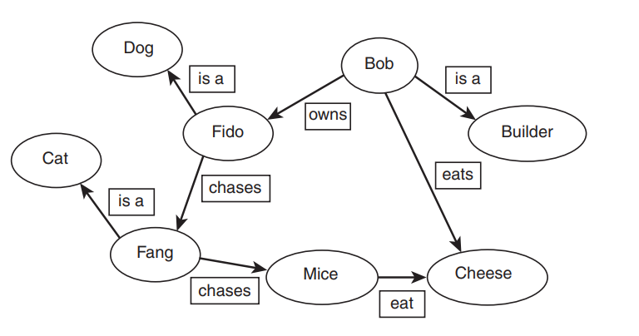

Slide 15
Example
Tom is a cat.
Tom caught a bird.
Tom is owned by John.
Tom is green in color.
Cat likes cream.
Cat sat on the mat.
A cat is a mammal.
A bird is an animal.
All mammals are animals.
Mammals have fur.

Slide 16
Frames
Frame-based representation is a development of semantic nets and allows us to express the idea of inheritance.
A frame system consists of a set of frames (or nodes), which are connected by relations. Each frame describes either an instance (an instance frame) or a class (a class frame).
Each frame has one or more slots, which are assigned slot values.

Slide 17
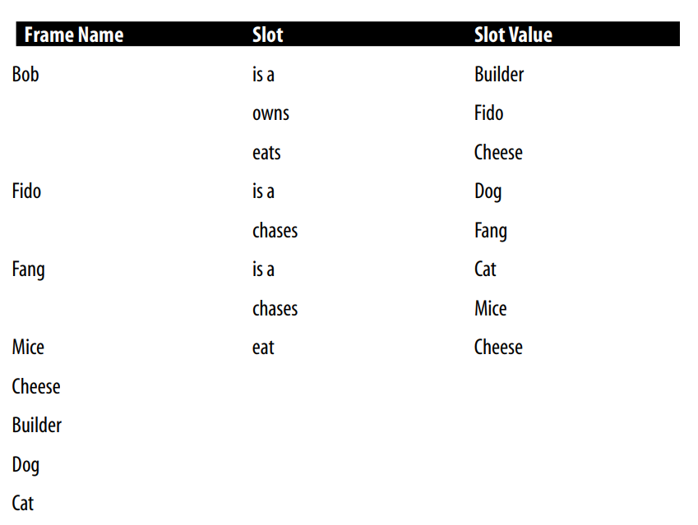

Slide 18
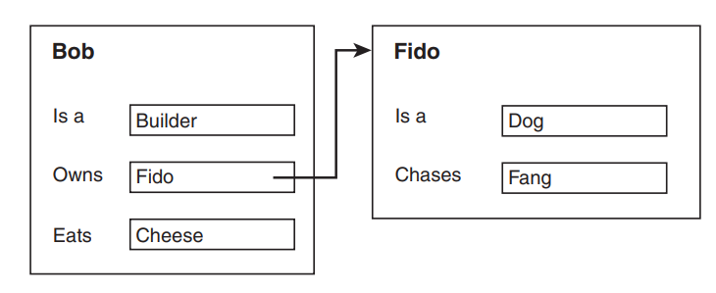

Slide 19
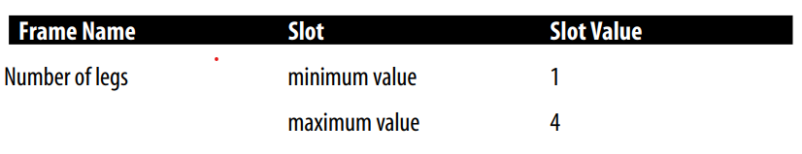
Slots as Frames
It is also possible to express a range of values that a slot can take.
One way to express this kind of restriction is by allowing slots to be frames.

Slide 20
Search Spaces
A search space is a representation of the set of possible choices in each problem, one or more of which are the solution to the problem.
A search space consists of a set of states, connected by paths that represent actions.
Also known as state spaces.
Arrows between states represent state transitions.

Slide 21
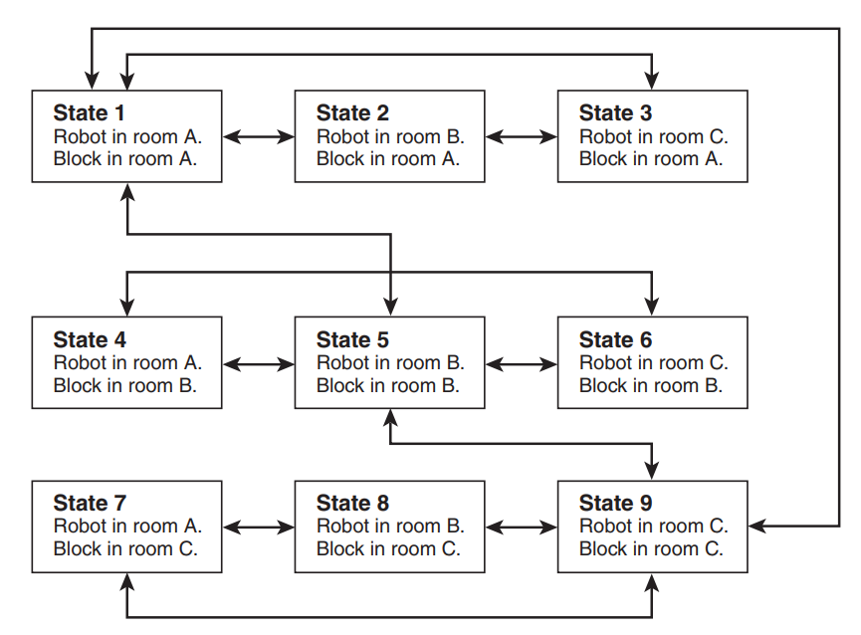

Slide 22
Semantic trees
A semantic tree is a kind of semantic net that has the following properties:
Each node (except for the root node, described below) has exactly one predecessor (parent) and one or more successors (children).
One node has no predecessors. This node is called the root node.
Some nodes have no successors. These nodes are called leaf nodes.
One or more leaf nodes are called goal nodes. These are the nodes that represent a state where the search has succeeded.
An ancestor of a node is a node further up the tree in some path. A descendent comes after a node in a path in the tree.
A path that leads from the root node to a goal node is called a complete path.
A path that leads from the root node to a leaf node that is not a goal node is called a partial path.
An edge that connects two nodes is called a branch.
If a node has n successors, that node is said to have a branching factor of n.
The root node of a tree is said to be at level 0, and the successors of the root node are at level 1.

Slide 23
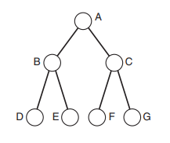
Terminologies
Root
Parent
Children
Leaf nodes
Goal nodes.
Ancestors.
Descendants.
Path.
Complete path.
Partial path.
Level.

Slide 24
Search trees
Searching a semantic net involves traversing the net systematically (or in some cases, not so systematically), examining nodes, and looking for a goal node.
Possible paths through a semantic net can be represented as a search tree.
Search trees are data structures used to represent the exploration of possible solutions or states in a search problem

Slide 25
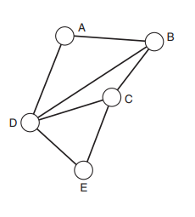
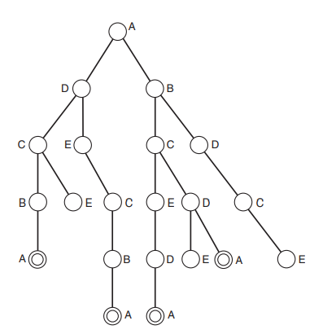
A search tree representation for the semantic net

Slide 26
Missionaries and Cannibals
Three missionaries and three cannibals are on one side of a river, with a canoe. They all want to get to the other side of the river. The canoe can only hold one or two people at a time. At no time should there be more cannibals than missionaries on either side of the river, as this would probably result in the missionaries being eaten.

Slide 27
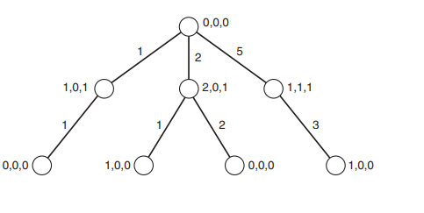

Slide 28
